Slide 1

ResearchCollab (SDP-27)
Backend-Focused Research Collaboration Platform
Technology highlights: Django, PostgreSQL, Bootstrap ·
Our Team: Sai Kumar Gowtham Om Prakash

Slide 2


Software Defined Perimeter:
Collaboration Friction
Secure Project Access
Researchers face scattered tools, inconsistent access, and version issues across projects.
Need for project-scoped authentication and fine-grained permissions to protect sensitive work.
Document & Communication Controls
Document sharing and discussion must be auditable, permissioned, and attached to projects.

Slide 3
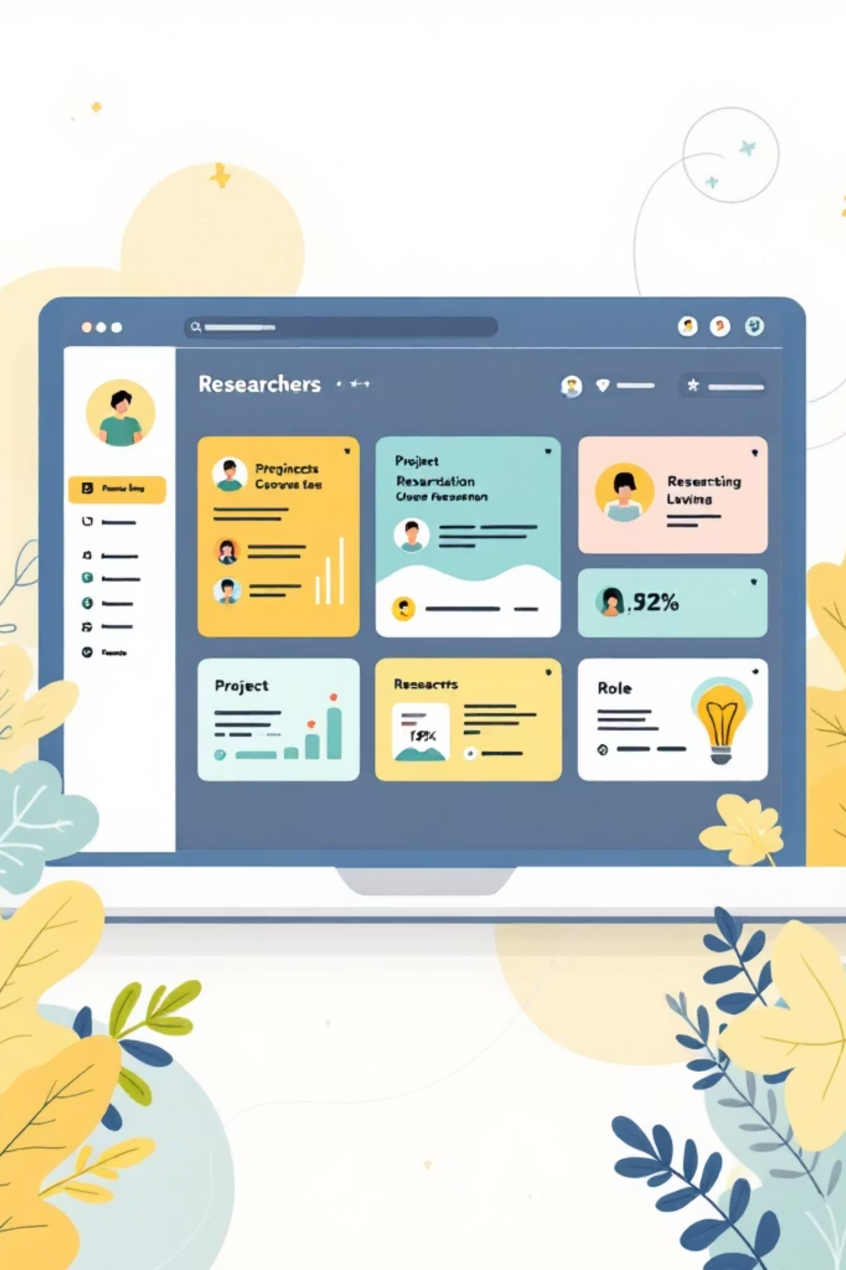


Solution Overview
ResearchCollab provides a centralized, server-rendered web platform that organizes research work by projects, enforces role-based access control, and integrates document management and scoped communication.
Role-Based Access
Admin and Researcher roles with enforced permissions for actions and data visibility.
Server-Rendered Architecture
Django templates deliver pages securely from the server — no separate SPA framework.

Slide 4
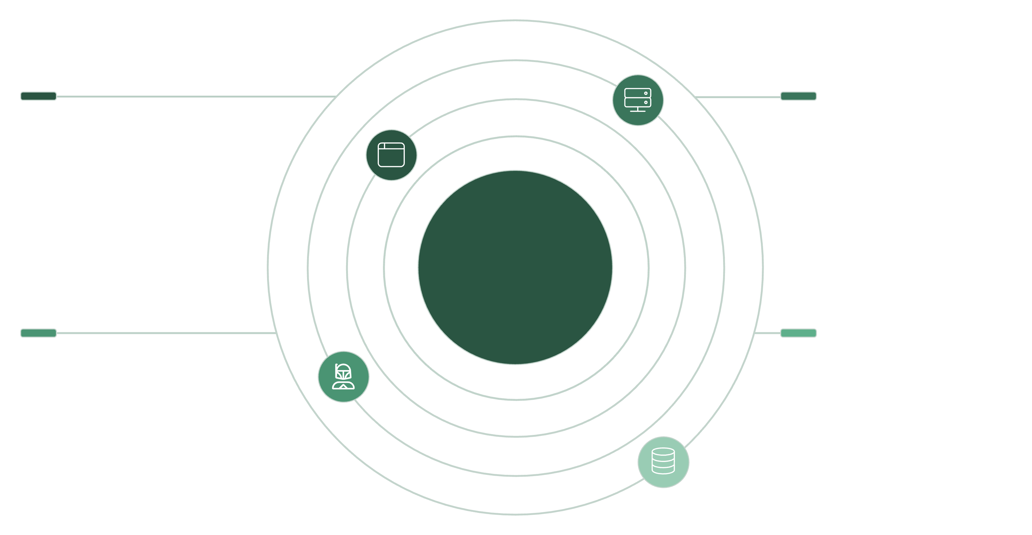




Browser
Gunicorn
User requests and responses
WSGI server forwarding requests
Monolithic Django Architecture
Django (MTV)
PostgreSQL & Files
Templates, Views, Models
Database, WhiteNoise static, media storage
Monolithic Django architecture following the MTV pattern. Server-side rendering with Django templates, secure role checks in views, and centralized data in PostgreSQL.

Slide 5
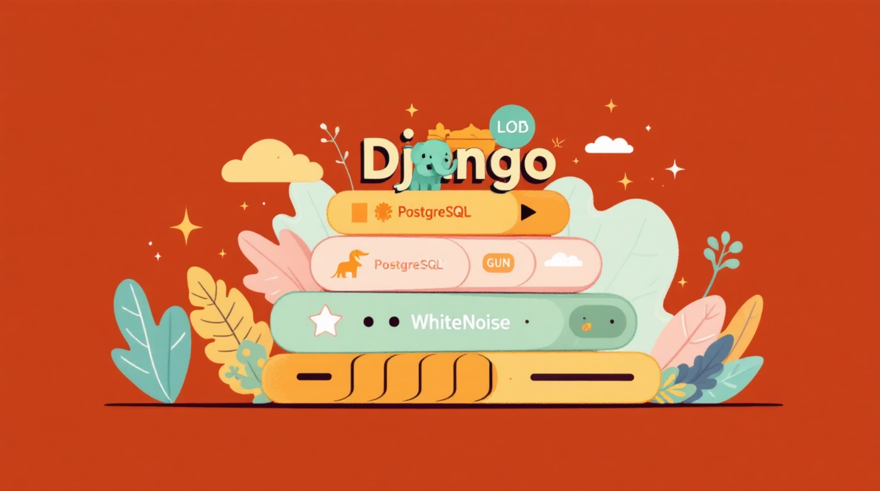
Technology Stack
Backend Framework: Django (core app, auth, ORM)
Database: PostgreSQL (relational integrity, transactions)
Frontend Rendering: Django Templates + Bootstrap (responsive server-rendered UI)
Authentication: Django Auth System (sessions, password hashing)
Deployment: Render + Gunicorn (WSGI)
Static Files: WhiteNoise (efficient static serving)

Slide 6





Project Folder Structure
Modular app-based layout for separation of concerns and maintainability. Root folders shown with responsibilities.
researchcollab/
apps/
templates/
static/
Contains modular Django apps: accounts, projects, documents, communication.
Server-rendered HTML templates (base, project pages, auth flows) using Bootstrap components.
CSS, JS, images — served via WhiteNoise in production; collected by collectstatic.
Main project settings, WSGI/ASGI entry, global configuration, environment-aware settings.
media/
Uploaded project documents and attachments, referenced by MEDIA_ROOT and MEDIA_URL.

Slide 7
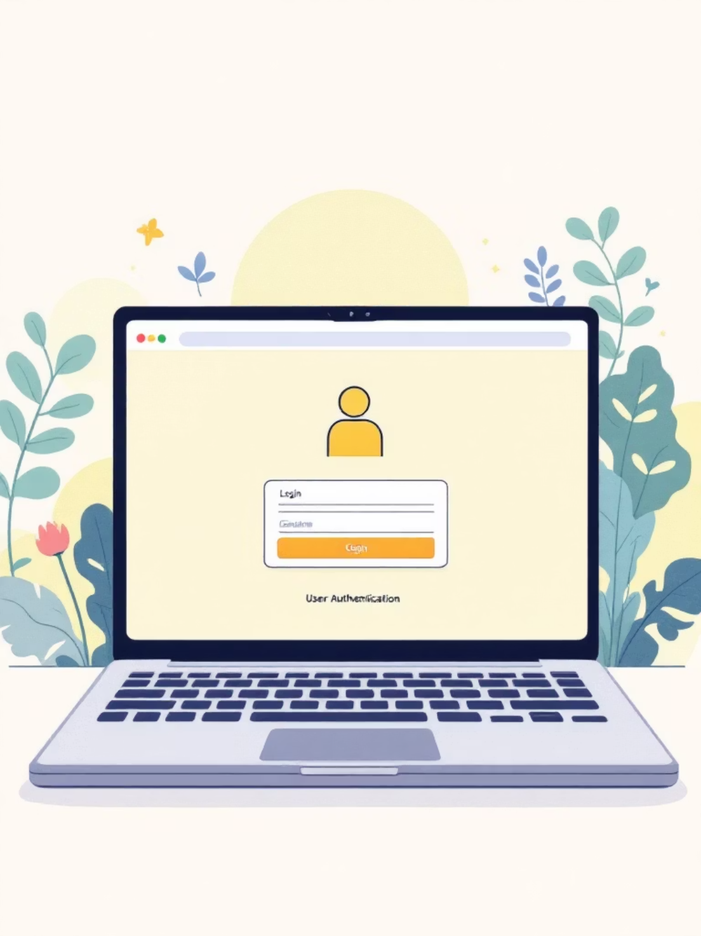

Accounts Module
Handles authentication and authorization with Django's auth system plus profile-based role management. Implemented features:
User registration, login, logout, password set/change flows (Django auth views and custom forms)
Profile model extends User with role attribute (Admin | Researcher)
Role enforcement via decorators and mixins (e.g., @login_required, RoleRequiredMixin)
Role checks occur in view entry points; Admins have elevated permissions and can manage projects and users.

Slide 8
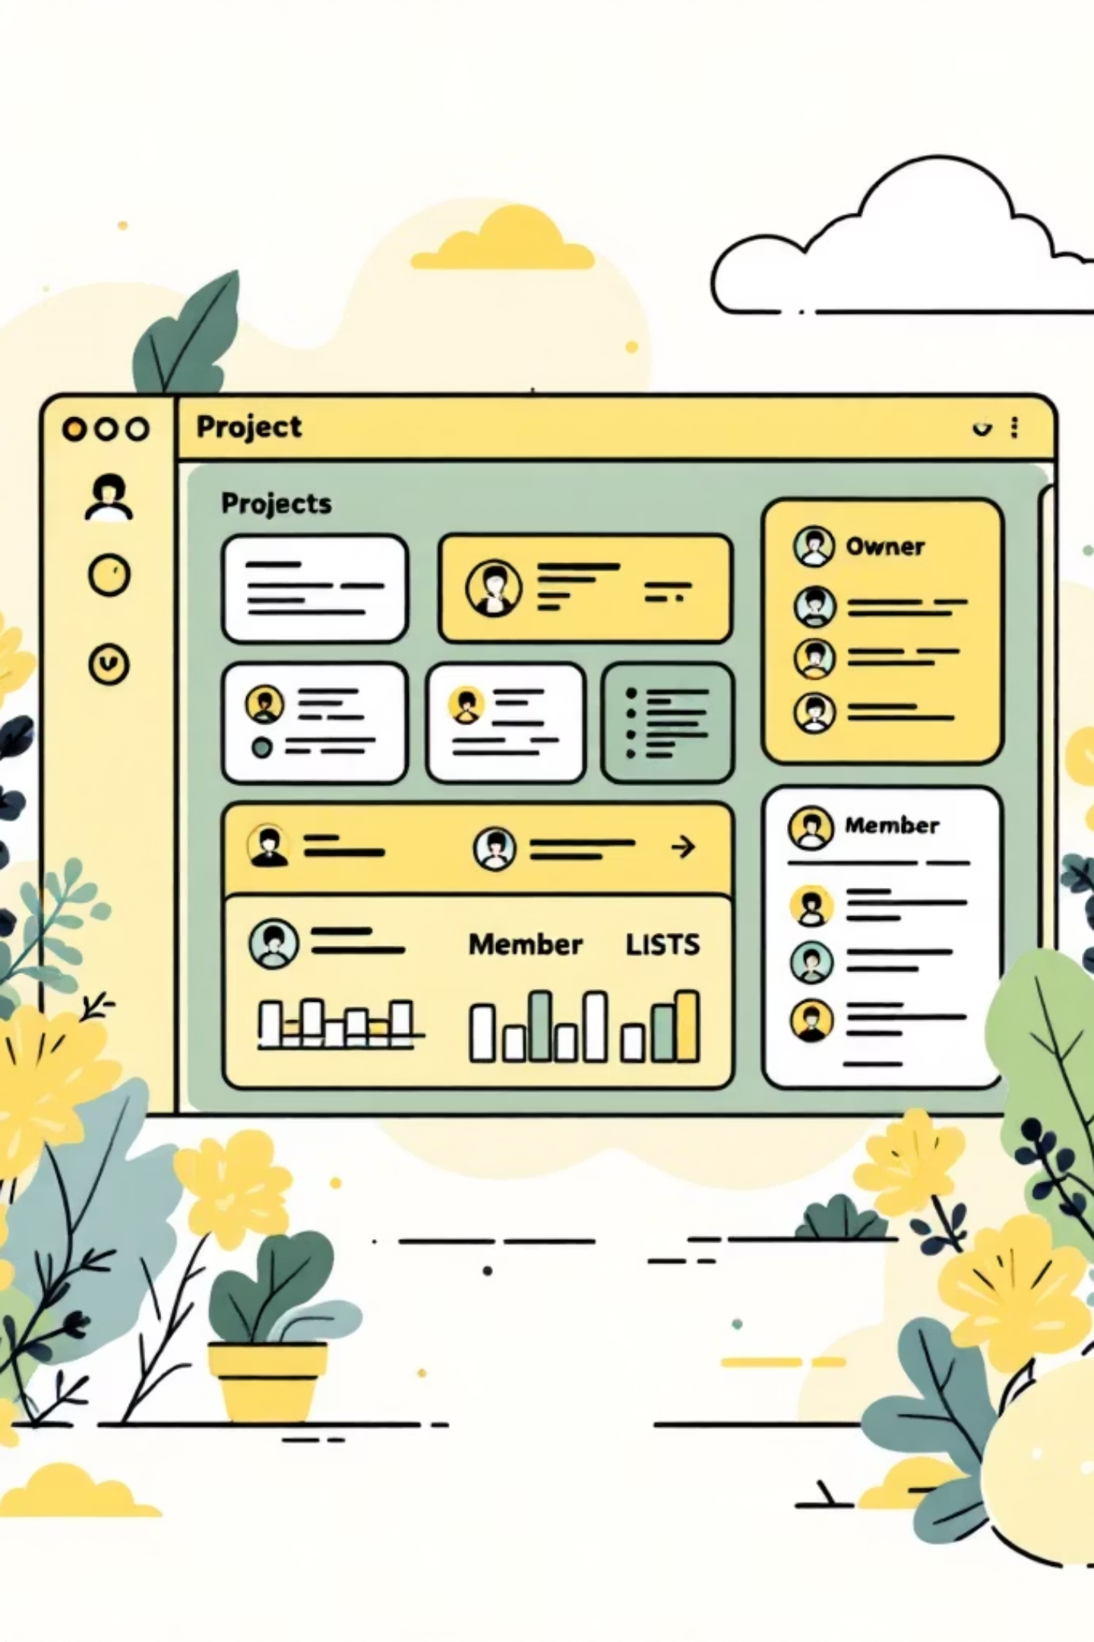
Projects Module
Core Features
Access Control
Business Logic
Create projects, assign researchers, track status, view project details (models: Project, Membership, Status).
Project ownership and membership model define access. View-level checks ensure only members can access project resources.
Ownership enforced via ForeignKey(owner) and Membership records; queries filter by membership for list/detail views.

Slide 9
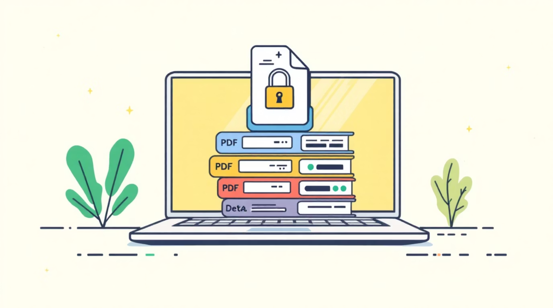
Documents Module
File management scoped to projects with permission checks for upload and download.
Project-scoped document uploads stored under MEDIA_ROOT organized by project ID
Permission-based access — download views validate membership and project permissions
Media handling: MEDIA_ROOT and MEDIA_URL set in settings; served in dev by Django, in production via cloud storage or WhiteNoise proxy
Example: Upload view enforces request.user in Project.members before saving FileField to project's media directory.

Slide 10
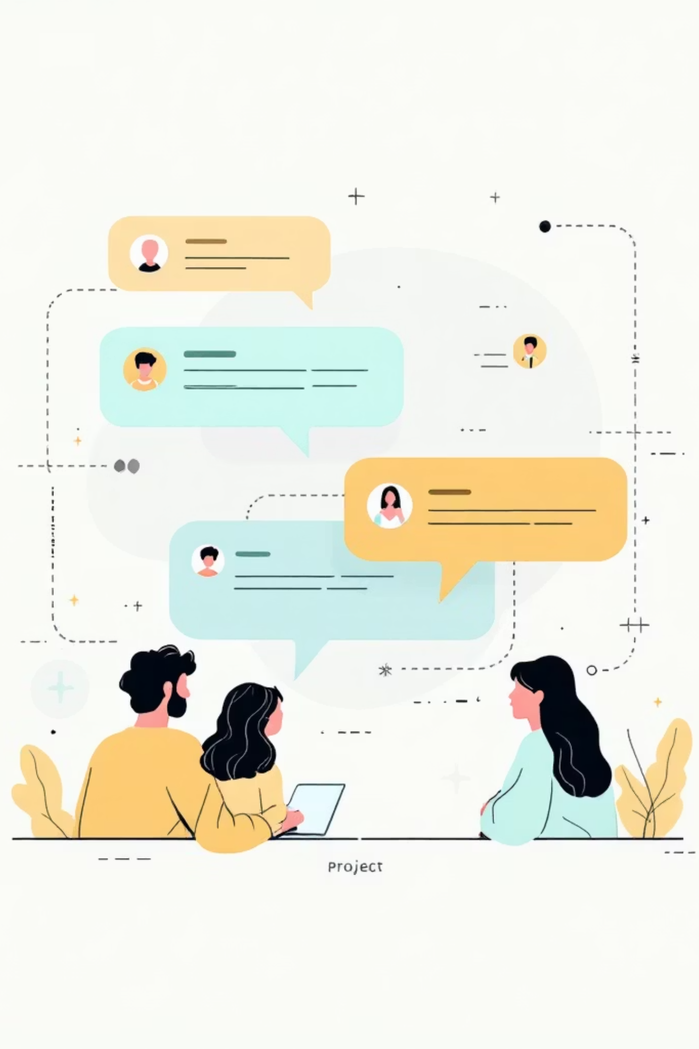
Communication Module
Persistent, project-based discussion threads with access limited to project members. Messages are stored in the database and linked to a Project foreign key.
01
02
Thread Model
Access Enforcement
Thread and Message models link to Project and Author; created via authenticated views.
Views validate project membership before returning threads or accepting posts.
03
Persistent Storage
Messages persisted in PostgreSQL; retrieval optimized with select_related for author and project.

Slide 11

Routing
Complete route map for ResearchCollab — all public application routes organized by section for quick reference.
Authentication
Page
URL
Method(s)
Description
Login
/login/
GET, POST
Sign in to your account
Logout
/logout/
GET
Sign out of your account
Register
/register/
GET, POST
Create a new account
Change Password
/password-change/
GET, POST
Change your current password
Password Reset
/password-reset/
GET, POST
Reset a password (if one exists)
Set Password
/password-set/
GET, POST
Set a password (if none exists)
Dashboards
Page
URL
Method(s)
Description
Dashboard (Redirect)
/dashboard/
GET
Redirects to role-based dashboard
Admin Dashboard
/admin-dashboard/
GET
Dashboard for ADMIN users
Researcher Dashboard
/dashboard/researcher/
GET
Dashboard for RESEARCHER users
Projects
Page
URL
Method(s)
Description
Project List
/projects/
GET
List all projects (role-filtered)
Create Project
/projects/create/
GET, POST
Create a new project
Project Detail
/projects/<id>/
GET
View project details
Edit Project
/projects/<id>/edit/
GET, POST
Edit a project (ADMIN only)

Slide 12

Documents
Page
URL
Method(s)
Description
Document List
/documents/projects/<project_id>/
List documents for a project
GET
Upload Document
/documents/projects/<project_id>/upload/
Upload a document to a project
GET, POST
Communication
Page
URL
Method(s)
Description
Project Messages
/communication/projects/<project_id>/messages/
GET, POST
View and post messages for a project (project-member access only)

